Slide 1
EV vs Petrol vehicles

Slide 2
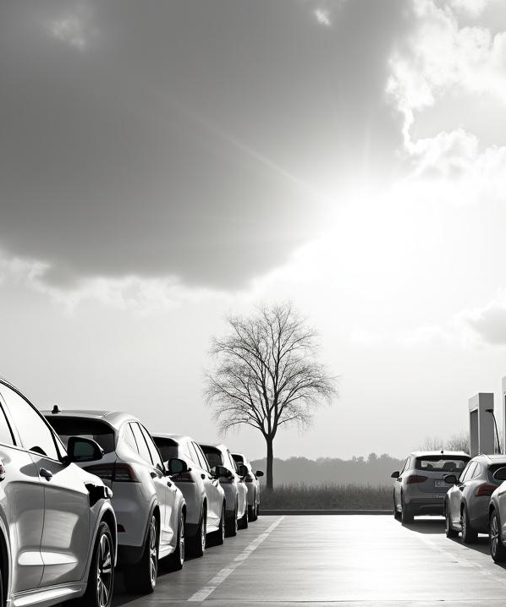
Introduction
This presentation explores the key differences between electric vehicles (EVs) and petrol vehicles. We will analyze aspects such as environmental impact, operating costs, and infrastructure challenges to provide an informed overview for stakeholders and decision-makers.

Slide 3
Environmental Impact
Electric vehicles produce significantly lower greenhouse gas emissions compared to petrol vehicles, contributing to cleaner air and reduced climate change effects. EVs rely on electricity, which can come from renewable sources, unlike petrol engines that emit CO2 and pollutants during fuel combustion.

Slide 4

Operating Costs
EVs offer lower operating costs due to reduced fuel expenses and less frequent maintenance. Petrol vehicles require regular servicing and incur higher fuel costs. Over time, EVs can provide significant savings despite initially higher purchase prices.

Slide 5
Performance and Range
Electric vehicles typically offer rapid acceleration and smooth operation due to their electric motors. However, EVs generally have a shorter driving range compared to petrol vehicles, constrained by current battery technology. Advances are closing this gap, but petrol vehicles still provide longer ranges and faster refueling times, which remain an advantage for long-distance travel.

Slide 6
Charging vs Refueling Networks
Petrol vehicles benefit from an extensive and mature refueling infrastructure, allowing fast and widespread access to fuel. In contrast, EV charging networks are expanding but vary widely by region, with slower charging times requiring longer stops. Continued investment in fast-charging stations is critical to support widespread EV adoption.

Slide 7
THANK YOU

